Slide 1
Explore Bronze Update Clinic
Galactic Bronze Video

Slide 2
Objectives
Highlight key elements of the Society’s revised Bronze medal awards.
Explore teaching and evaluating implications for instructors and examiners.
Familiarize participants with the new Bronze Medals Award Guide and related support resources.

Slide 3
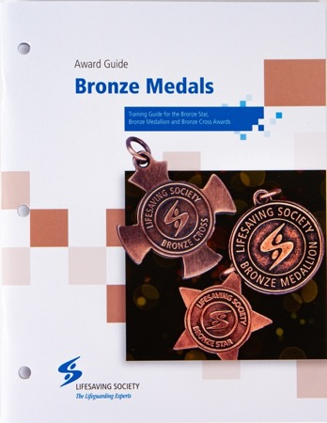
Learning Outcomes
Understand major changes in the Bronze medal awards and how they may affect instruction and evaluation
How to use the Bronze Medals Award Guide
Know where to locate updated Bronze resources

Slide 4
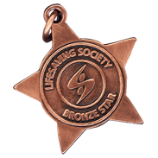
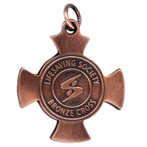
Why Update?
The Lifesaving Society updated its Bronze medal awards:
To reflect the Society’s current research into drowning in Canada.
To focus on the four components of a successful water rescue: skills, knowledge, fitness and judgment.
To improve skills progressions for a logical and seamless flow into National Lifeguard.
Notes:
What Instructors should know:
The Lifesaving Society has updated its Bronze medal awards to reflect the Society’s current research into drowning in Canada.
The awards focus on the four components of a successful water rescue: each level is divided into four sections, skills, knowledge, fitness and judgment.
The program features improved skills progressions for a logical and seamless flow into National Lifeguard.
Candidates will have a greater understanding of the incidence and consequences of non-fatal drowning.
It also sets candidates up for success as they move through the Society’s lifesaving, assistant lifeguard, and lifeguard continuum.

Slide 5
Key Changes
Bronze Star focuses on swimming proficiency, lifesaving skill and personal fitness.
Bronze Medallion reintroduces strokes.
Bronze Cross contains fundamental assistant lifeguarding skills.
First aid items are restricted to content that relates directly to water rescue.
To ensure national consistency, the Society identifies mandatory items to be evaluated in Bronze Medallion and Bronze Cross recertifications.
Notes:
Here are some key changes to the program
- Bronze Star content focuses on swimming proficiency, lifesaving skill and personal fitness.
- Bronze Medallion reintroduces swim stroke requirements.
- Bronze Cross contains fundamental assistant lifeguarding skills.
- First aid items are restricted to content that relates directly to water rescue; old items that were mirrored in standard first aid or emergency first aid are no longer in the new program.
-To ensure national consistency, the Society identifies the mandatory items to be evaluated in Bronze Medallion and Bronze Cross recertifications. This is new. If you are conducting a Bronze Med. or Cross recertification, there are specific items that you will evaluate during that exam. This is similar to National Lifeguard.
- Strokes are back – by popular demand: We heard loud and clear from parents, instructors, and affiliates that young swimmers need opportunities to continue to develop their swim strokes in lifesaving classes. In the new Bronze Star and Medallion participants will hone their front and back crawl, breaststroke and lifesaving kicks.
Bronze Cross includes concepts needed by those responsible for safety supervision, example scanning.
First Aid drowning resuscitation remains the central focus throughout the Bronze medal awards.

Slide 6
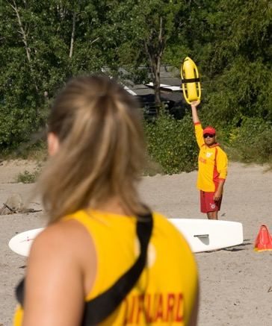
Bronze Cross is Assistant Lifeguard
Now more than ever, the new Bronze Cross prepares candidates for responsibilities as assistant lifeguards.
Bronze Cross features more lifeguarding content with an emphasis on the principles and techniques of active surveillance in aquatic facilities.
Candidate assessment includes Assistant Lifeguard Situations.
Notes:
- Now more than ever, the new Bronze Cross prepares candidates for responsibilities as assistant lifeguards.
- Bronze Cross features more lifeguarding content with an emphasis on the principles and techniques of active surveillance in aquatic facilities.
- Candidate assessment includes Assistant Lifeguard Situations. These are similar to – but more limited than - National Lifeguard situations.

Slide 7
Programming
Programming blocks:
Bronze Star (10 hr.)
Bronze Medallion (15 hr.)
Bronze Cross (20 hr.)
No additional equipment needed: The usual rescue aids, CPR manikins and equipment commonly found at aquatic facilities will suffice.
Co-delivering first aid awards with Bronze awards | Total Hr.
Basic First Aid + Bronze Star | 12
Emergency First Aid + Bronze Medallion | 20
Emergency First Aid + Bronze Cross | 25
Standard First Aid + Bronze Cross | 30
Notes:
What Instructors should know:
- The revised Bronze medal awards are designed for candidates to achieve success within the recommended programming time blocks. The above outlines the minimum additional time needed for the average candidate to achieve the required standard. Additional time may be needed for learning activities such as skills practice and situational training, breaks, etc.
- The Bronze medal awards emphasize the first aid skills needed to deal with drowning victims. First aid skills learned in public first aid courses are not included in the new Bronze curriculum. This means instructors can devote more time to helping candidates master important water rescue skills.

Slide 8
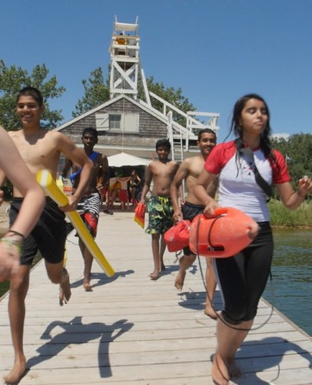
Transition
Instructors need to be prepared to teach the new awards when their employer adopts the revised program (before June 30, 2022):
Review programming times
Purchase updated award guide
Familiarize yourself with new resources
Update lesson plans in preparation to teach
Notes:
Instructors should be prepared to teach the new Bronze medal awards whenever their employer switches to the new progam.
We do want instructors to consider the following before they start teaching:
To review the programming times
To purchase the updated award guide
To familiarize yourself with the new resources
And to review lesson plans and prepare to teach
- The main point is that we want to ensure you familiarize yourself with the new content before teaching.

Slide 9
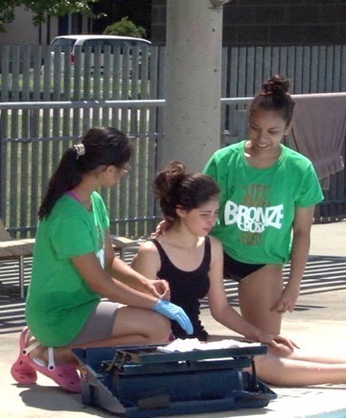
Bronze Exams
All items in Bronze Star and most items in Medallion and Cross remain instructor-evaluated. When a separate examination is required, allow for the following:
Approximately 2.5 to 3 hr. for a Bronze Medallion or Bronze Cross exam with 12-16 candidates.
Notes:
All items in Bronze Star and most items in Bronze Medallion and Bronze Cross remain instructor-evaluated.
When a separate exam is required, please be prepared for approximately 2.5 to 3.0 hr. for a Bronze Medallion or Bronze Cross exam with 12-16 candidates.

Slide 10
Recertification Exams
For new Bronze Medallion and Bronze Cross recertification exams, the Society has identified the mandatory (and only) items to be evaluated.
For 12–16 candidates, allow approximately:
Bronze Medallion Recertification = 3 hr. (previously 4–5 hr.)
Bronze Cross Recertification = 4 hr. (previously 5–6 hr.)
Please use only the new Recertification test sheets.
Notes:
For recertification exams that have 12 to 16 candidates, please allow for:
Approx. 3 hr. for Bronze Medallion recertification; approx. 4 hr. for Bronze Cross recertification
Previously, Bronze Medallion and Cross recertification exams took approximately 4 to 5 hr. and 5 to 6 hr., respectively
So we can see that the new program will allow for quicker recertification exams.
There is a separate test sheet that examiners must use when conducting a Bronze Medallion and Bronze Cross recertification exam in the new program.

Slide 11
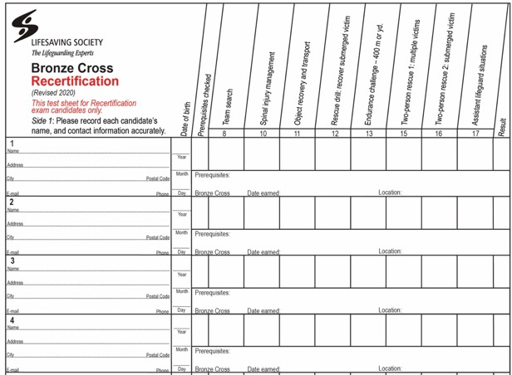
Recertification Test Sheets
Notes:
- Please use only Recertification test sheets for Medallion or Cross recertification exams.

Slide 12
Bronze Medallion Recertification
These are the only items evaluated at a new Bronze Medallion recertification:
Item 5: Self-Rescue
Item 9: Defences and Releases
Item 12: Submerged Victim Recovery
Item 15: Endurance Challenge
Item 17: Rescue 1 – From Land
Item 18: Rescue 2 – Open Water
Item 19: Rescue 3 – Non-Breathing Victim
Notes:
Review items

Slide 13
Bronze Cross Recertification
These are the only items evaluated at a new Bronze Cross recertification:
Item 8: Team Search
Item 10: Spinal-Injury Management
Item 11: Object Recovery and Transport
Item 12: Rescue Drill
Item 13: Endurance Challenge
Item 15: Two-Person Rescue 1 – Multiple Victims
Item 16: Two-Person Rescue 2 – Submerged Victim
Item 17: Assistant Lifeguard Situations
Notes:
Review items

Slide 14
Program Structure
Award content developed and organized to align with the four components of successful water rescue:
Judgment
Knowledge
Skill
Fitness
Notes:
The awards are now organized into 4 sections, Judgment, Knowledge, Skill and Fitness – the 4 components of a successful water rescue.

Slide 15
Bronze Star At-A-Glance
Knowledge Items | Fitness Items
1. The Lifesaving Society | 9. Obstacle Swim 10. Rescue Drill 11. Fitness Challenge
Skill Items
2. Self-Rescue 6. Victim Recognition 3. Entries 7. Reaching and Throwing Assists 4. Swimming and Lifesaving Strokes 8. Drowning Resuscitation 5. Sculling
Items in bold are new or are significantly modified. They are reviewed in upcoming slides.
Notes:
- The next three slides shows each Bronze level at a glance and I encourage you to follow along in your Award Guide.
The items in bold are new or have changed and will be discussed in a little more in depth: open your award guide open at the appropriate page.

Slide 16
Bronze Medallion At-A-Glance
Knowledge Items | Skill Items
1. The Lifesaving Society 2. Drowning Chain of Survival 3. Rescue Process 4. Cold water | 5. Self-Rescue 6. Swimming and Lifesaving Strokes 7. Victim Recognition 8. Entries and Removals 9. Defences and Releases 10. Tows and Carries 11. Search 12. Submerged Victim Recovery 13. Drowning Resuscitation
Fitness Items | Judgment Items
14. Rescue Drill 15. Endurance Challenge | 16. Risk Assessment and Response 17. Rescue 1: From Land 18. Rescue 2: Open Water 19. Rescue 3: Non-Breathing Victim
Items in bold are new or are significantly modified. They are reviewed in upcoming slides.

Slide 17
Bronze Cross At-A-Glance
Knowledge Items | Skill Items
1. The Lifesaving Society 2. Non-Fatal Drowning 3. Shallow Water Blackout 4. Assistant Lifeguard Roles and Responsibilities | 5. Communication 6. Two-Rescuer Removals 7. Surface Dives and Underwater Swims 8. Team Search 9. Two-Rescuer Drowning Resuscitation 10. Spinal Injury Management
Fitness Items | Judgment Items
11. Object Recovery and Transport 12. Rescue Drill 13. Endurance Challenge | 14. Safety Supervision Scanning 15. Two-Person Rescue 1: Multiple Victims 16. Two-Person Rescue 2: Submerged Victim 17. Assistant Lifeguard Situations
Items in bold are new or are significantly modified. They are reviewed in upcoming slides.

Slide 18
Lifesaving Society
The Lifesaving Society is a “Knowledge” item in each Bronze level with a focus on:
Canada’s Lifeguarding Experts
Charitable organization
Drowning prevention mission
Setting aquatic standards
Training beyond the Bronze level
Bronze Medal Awards Item 1: CLM Ch. 1.4
Notes:
- All three levels include a knowledge item about the Lifesaving Society.
In Bronze Star, candidates must be able to state the Lifesaving Society’s mission and give 2 examples of lifesaving society training opportunities available beyond Bronze Star
In Bronze Medallion, candidates must be able to state the Lifesaving Society’s motto and to identify 2 examples of how the Lifesaving Society pursues its drowning prevention mission. They must also be able to give 2 examples of Lifesaving Society training opportunities available beyond Bronze Medallion.
In Bronze Cross, candidates must be able to identify an example of how the Society’s aquatic safety standards contribute to its drowning prevention mission. They must also be able to identify the Lifesaving Society’s role in the training and certification of Canada’s lifeguards and provide 2 examples of Lifesaving Society training opportunities available beyond Bronze Cross including National Lifeguard.
When teaching these items, I encourage you to allow students to use their laptops and phones to search the Society’s website, as well as use resources like the Canadian Lifesaving Manual to learn about the Lifesaving Society.

Slide 19
Swimming & Lifesaving Strokes
Develop effective strokes for use in water rescue emergencies
Swim 25 m: front crawl, back crawl, breaststroke
Swim 25 m: head-up front crawl, head-up breaststroke
Swim 25 m: whip kick, eggbeater, scissor kick
BS Item 4, BM Item 6: CLM Ch. 9
Bronze Videos: Rescuer’s Checklist
Notes:
What instructors should know:
This item is repeated in both Star and Med.
Follow the Must Sees (evaluation standard based on Swimmer 6 – see Appendix C – Characteristics of Swimming Stroke Mechanics):
We want to avoid instructor spending too much time on this item, over-correcting strokes.
Variations in body type, physical limitations, strength and flexibility, etc. affect an individual’s strokes. In all strokes, swimmers aim for strong, smooth propulsion over the distance. The overall propulsion and flow of the stroke is more important that precision of the details. Focus on building proficient and efficient strokes

Slide 20
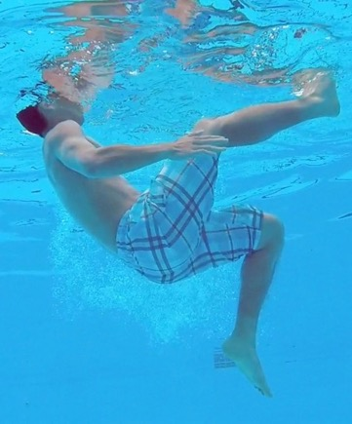
Sculling
Develop effective sculling mechanics with control of direction
In ready position
Scull in place for 30 seconds
Scull head-first 10 m and scull feet-first 10 m
Stationary scull: minor travel is acceptable
Travelling scull: completed as continuous sequence
Item 5: CLM Ch. 4.10
Bronze Videos: Rescuer’s Checklist
Notes:
What instructors should know:
Strong sculling skills are a great advantage in lifesaving. This Bronze Star item gives candidates opportunity to develop this proficiency early.
This is an excellent progression to Reverse and Ready.
Once candidates have achieved the time and distance standards, challenge them with longer times and distances.

Slide 21
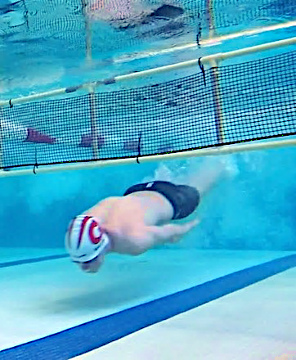
Obstacle swim
Swim 50 m submerging under an obstacle twice during the swim
Quick approach and head-first under obstacle
Efficient underwater movement, return to surface
Quick departure from obstacle
Distance completed in a continuous sequence
Item 9: CLM Chap. 9.2 and 9.3
Notes:
What instructors should know:
This item, an introduction to lifesaving sport, is an example of how instructors might use lifesaving sport events as fun learning activities to develop skill and fitness.
Encourage candidates to contact their local lifesaving club or the Lifesaving Society for more information about lifesaving sport.
Lifesaving sport obstacles are recommended but not required, a simple rope at the surface (e.g., buoy line) or other objects (e.g., Floating mat, hoop, lane rope) can be used as obstacles – as long as they require candidates to fully submerge.

Slide 22
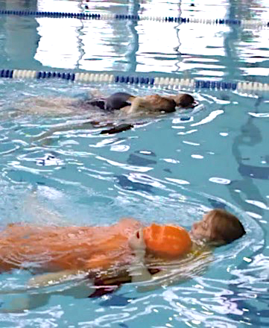
Rescue drill
To develop fitness in a sequence of water rescue skills
Featured in each Bronze level
Progressively more difficult
Progression to National Lifeguard
Item 12: CLM Ch. 9 and 10
Notes:
There is a rescue drill in each Bronze level.
In Bronze Star, on the instructor’s signal, don a shoulder loop and line, enter the water and swim head-up to a partner or manikin located at the surface 25 m or yd. away. Tow partner or manikin to starting position.
In Bronze Medallion, enter the water and swim head-up 25 m or yd. to contact a passive victim or manikin located at the surface and carry 25 m or yd.
In Bronze Cross, starting in the water, swim head-up to recover a submerged manikin or victim located 20 m away; surface and carry the manikin or victim 20 m to starting point – all within 120 seconds.
We can see that these skills progress to the National Lifeguard rescue drill, which should help candidates be successful at these items.

Slide 23
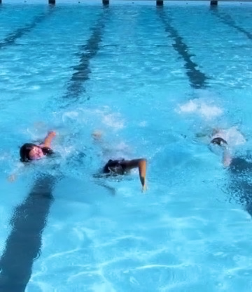
Fitness challenge
Bronze Star: 400 m fitness training workout
100 m warm-up
6 x 25 m one of: front crawl, back crawl, breaststroke, or lifesaving kick
2 x 50 one of: head-up front crawl or head-up breaststroke
50 m cool-down
Bronze Medallion: Swim 400 m within 12 min.
Bronze Cross: Swim 400 m within 11 min.
National Lifeguard: Swim 400 m within 10 min.
Item 11: CLM Ch. 9.2, 10
Notes:
What Instructors should know
- Bronze star introduces the FITT principles:
- Frequency (how often)
- Intensity (how hard)
- Time (how long)
- Type (what kind)
Monitoring heart rate, strokes per length, and time per length can all be used to teach the concept of pacing. Use heart rate checks to guide work-rest ratios. Candidates locate and count their own pulse before the workout begins and after.
We can also see the natural progression from Bronze Medallion all the way to National Lifeguard

Slide 24
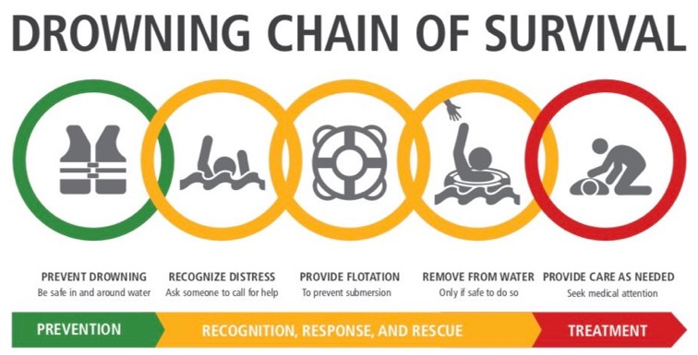
The Drowning Chain of Survival describes five steps that help guide a rescuer’s actions. It provides a “general” overview of rescues.
New Bronze Medallion Knowledge Item
Explain how lifesavers apply the Drowning Chain of Survival
Item 2: CLM Ch. 4 Bronze Award Guide - Supplement
Notes:
The drowning chain of survival describes 5 steps that help guide a rescuer’s actions. It provides a general overview of rescues.
Learning Activity: provide each participant in your clinic with a card with an image on it resembling one of the links of the chain of survival.
They must mingle and create their group of five and put themselves in order
The group will then spend some time reviewing the importance of each link in the chain and how they would communicate this to lifesaving candidates
For Example:
Prevent Drowning – ask the candidates what they would tell the candidates about how to prevent drowning. Wear a lifejacket, ensure you have the ability to swim to survive, swim with a buddy, swim in lifeguarded areas, stay within arm’s reach.
Recognize Distress – ask the candidates what distress sounds and looks like. Someone who is away from the edge/safety point, panic eyes, struggling to move in a forward direction, calls for help, appears in pain
Provide Flotation – what types of floatation devices could be used in a variety of different locations? Lifejacket, ring buoy, cooler lid (something else buoyant that may be around).
Remove from the water – discuss how to do so: ladder, dock, carry out, with a bystander etc.
Provide care as needed – discuss common victim types that would be included in a Bronze course.

Slide 25
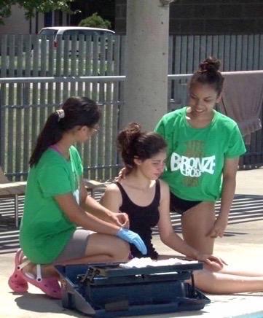
New Bronze Medallion Knowledge Item
Rescue Process
The Rescue Process involves three elements when considering how to respond to a rescue or self-rescue:
“Recognize” help is needed; “Assess” your situation; and “Act”
You may Recognize – Assess – Act many times, changing what you do as conditions change. It all depends on the rescue situation.
Item 3: CLM Ch. 4
Bronze Videos: Rescue Process
Notes:
What instructors should know:
The Ladder Approach and Rescuer’s Checklist are used to help rescuers to review their options and make the appropriate decisions.
Rescue must be taught using the rescue process with very strong emphasis on the ladder approach and rescuer’s checklist.

Slide 26
Rescue Process
The Ladder Approach in water rescue presents, in order of increasing risk, your options for helping someone in trouble in the water:
As a rescuer, you should always choose the rescue method that involves the least risk. The first “rung” on the ladder is a Talk Rescue – you encourage the victim to safety without even entering the water.
As a rescuer, you move up the rungs of the ladder if you have the knowledge, judgment, skill and fitness to manage greater risk.
Item 3: CLM Ch. 4
Bronze Videos: Ladder Approach
Notes:
Ability to explain the low-to high-risk progression of the Ladder Approach and the increasing risk to the rescuer.
Instructor must teach rescues so candidates demonstrate the ladder approach every time.

Slide 27
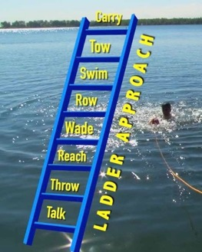
Rescue Process
The Rescuer’s Checklist is a guide to your actions to carry out your rescue:
How do you actually carry out a rescue? In any rescue other than a talk rescue, there are lots of ways to reach a victim, different methods to swim to a victim, and many ways to carry a victim.
Wherever you are on the ladder, use the check list to review your options on that rung and choose the appropriate option.
Item 3: CLM Ch. 4
Bronze Videos: Rescuer’s Checklist
Notes:
Ability to identify the components of the Rescuer’s Checklist.
Ability to explain the relationship between the Ladder Approach and Rescuer’s Checklist.

Slide 28
Non-fatal Drowning
New Bronze Cross Knowledge Item
Demonstrate knowledge of follow-up care and treatment of a conscious drowning victim
Identify signs and symptoms that may be exhibited by a non-fatal drowning victim
Recognize when to seek medical help
Describe when victim should seek follow-up medical attention
Item 2: CLM Ch. 8.3, 8.8
Alert Pg. 28
Notes:
When reviewing non-fatal drowning, the Canadian Lifesaving Manual is a great resource. Ensure to review sections on Drowning, Water Intoxication, and aspiration, all found in chapter 8.
Drowning outcomes may be fatal or non-fatal. Candidates should understand that victims who survive a drowning incident may exhibit a range of symptoms from mild and short-term to severe long-term impairment.

Slide 29
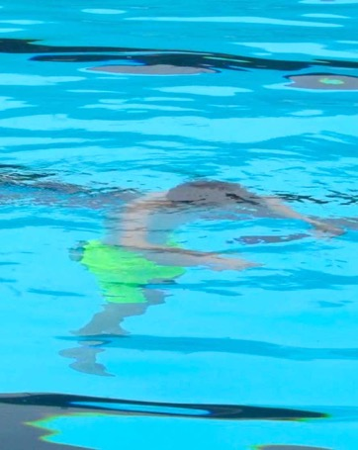
Shallow Water Blackout
New Bronze Cross Knowledge Item
Demonstrate knowledge of the cause and prevention of shallow water blackout. In groups, answer 1 of the following questions (must sees):
What are some causes of shallow water blackout?
What are some dangers of shallow water blackout?
Provide some examples of high-risk behaviours.
Provide some examples of proactive intervention.
Item 3: Alert Insert, Bronze Medals Award Guide - The Supplement
Notes:
The Bronze Medals Award Guide Supplement offers additional resources on teaching this topic.
Candidates must be able to explain the cause of shallow water blackout,
to provide examples of high-risk behaviours that lead to shallow water blackout
and to provide examples of proactive intervention to prevent shallow water blackout
This item might be evaluated in conjunction with item 14, Safety Supervision and Scanning.

Slide 30
Assistant Lifeguard Roles & Responsibilities
New Bronze Cross Knowledge Item
Demonstrate knowledge of the roles and responsibilities of an assistant lifeguard. What are the differences between the following:
Lifeguard
Assistant lifeguard
Lifesaver
Responsibilities to the public, fellow guards, the employer, and to one’s self
Item 4: CLM Ch. 4.2, Alert Ch. 1, 2 Bronze Medals Award Guide – Supplement
Notes:
You could teach this section with a learning activity. Put up three large flip chart papers up around the room, with titles Lifeguard, Assistant Lifeguard, and Lifesaver
Divide the class into 3 groups, and give them 2-3 minutes at each location where they brainstorm the roles of each
Then review answers together
Divide the class into 4. Each group will have one of the following responsibilities of the assistant lifeguard: to the public, to fellow guards, to the employer, or to one’s self.
Using their resources, each group will identify and present their topics
Using what they learned from these two stations (and time permitting), you could now have the groups put together a job posting for an Assistant Lifeguard
Candidates should be able to identify how lifesavers, assistant lifeguards and lifeguards differ in terms of their training, their roles and their responsibilities
Candidates should identify drowning and injury prevention as the key objectives of safety supervision. Techniques used in safety supervision include: scanning, positioning and rotation, role modeling, public education and rescue intervention
Be sure to share with candidates how lifeguards and assistant lifeguards are affected by relevant provincial/territorial government regulation and by employer hiring policies

Slide 31
Communication
Demonstrate effective communication with patrons and victims:
Clear and respectful verbal communication
Educate and explain safe practices
Personal modelling of safe practices
Communication with coworkers, supervisors and EMS:
Demonstrate 3 hand and 3 whistle signals
Can give and receive accurate directions
Clear and accurate communication with others in an emergency
Item 5: Alert Ch. 2, 3; Alert Insert Instructor Manual Pg. 30
Notes:
In this item, candidates need to demonstrate effective communication with patrons, victims, coworkers, supervisors, and emergency service personnel.
Verbal communication is the most affective means of preventing accidents or correcting behaviour.
Teach candidates to be brief and keep eyes on their supervised zone. If more than a few seconds are required, signal another assistant guard to cover your area.
When possible, candidates should be lowering themselves to the patron’s physical level and using respectful language.
What to say: Learn the victim’s name and use it. Identify yourself by name and let them know you are an assistant lifeguard. Let the victim know what you are going to do and ask permission.
The Bronze Medals Award Guide supplement includes information to assist in teaching this topic.
A system of hand or arm signals is a useful means of communication in facilities with good sight lines, and this must also be taught in Bronze Cross
You could try the Learning Activity called Signal It with your candidates– Position participants in a variety of locations throughout the facility. The first person gives a hand signal (example signals could include heart attack, stroke, unconscious victim, first aid, drowning non-swimmer, and others). The second person repeats the signal and adds another. Repeat until everyone has repeated the sequence, and added a signal. (A Variation could include how long can you keep the sequence going)

Slide 32
Two-rescuer Removals
With a partner, demonstrate ability to remove victims from various aquatic environments including a removal with a spineboard:
Ensure effective communication
Select appropriate removals for victim type and the environment
Know and practice several techniques
Use safe lifting techniques
Item 6: CLM Ch. 4.12, 5.10 Alert Pg. 49, 52, 62
Notes:
What instructors should know:
We encourage candidates to practice removing victims of different sizes to understand how this may affect removal options. During evaluation, candidates may select their own victim.
Candidates should develop a repertoire of removal techniques suitable for various circumstances including the following: walk out, ladder, knee step, hand step, under-arm lift, cradle lift, one-rescuer drag, and spineboard removal
Extraction with the assistance of a spineboard as a tool is new to the level, spine immobilization is not required, nor evaluated .

Slide 33
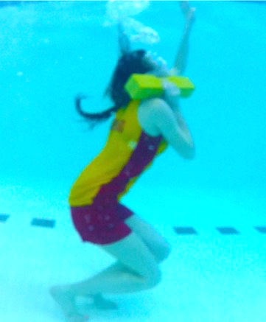
Object Recovery and Transport
Demonstrate aerobic fitness and strength for an object recovery:
In-water start and approach – 15 m
Surface dive to recover 4.5 kg (10 lb.) object
(20 lb. for National Lifeguard)
Surface and carry object 5 m
Head above surface throughout carry
Distance and carry – within 60 sec.
Item 11: CLM Ch. 4.9, 9.3 Bronze Medals Award Guide Appendix C
Notes:
What instructors should know:
This is a progression to National Lifeguard.
Where possible, place the object at a depth of 2 m. If the facility is less than 2 m, place the object at the deepest point, but not less than 1.5 m.
Candidates may swim head-up or head-down and use a head-first or foot-first surface dive.
Candidates may descend and ascend on an angle.
The 5 m carry distance is measured from the point at which the candidate surfaces with the object.
Object may be supported with one or two hands.
Candidates are not required to support the object at or near the surface.
Encourage candidates to hold the object close to the body.
Head above surface means candidates can breathe easily with jawline at or above the surface.
While eggbeater is encouraged, any leg action or combination of lifesaving kicks are acceptable.
Candidates may use goggles or mask but encourage them to complete the item without them.
Candidates need not place object on the deck or dock.

Slide 34
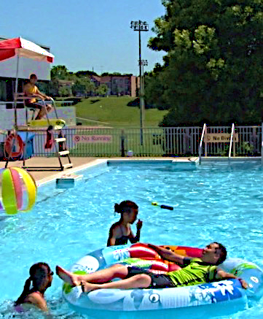
Safety Supervision Scanning
“Effective lifeguard positioning and systematic, continuous scanning are the foundation of the lifeguard surveillance system.” – Alert Insert, p. 1.
The new Bronze Cross Judgment Item (14) introduces principles and practices of this essential lifeguard skill.
Item 14: CLM Ch. 2; Alert Ch. 2, 3: Alert Insert; Instructor Manual, p. 87
Notes:
What Instructors should know:
This item has a large amount of additional information in the Bronze Medals Award Guide for teaching this topic.
There is a small gap, an old Lifesaving Instructor who does not have National Lifeguard would not have been taught scanning, so we are providing instructors with a lot of resources in this area to ensure this topic will be covered effectively when taught to Bronze Cross candidates.

Slide 35
Safety Supervision Scanning
Develop the ability to evaluate aquatic environments, activities and equipment for safety, and an understanding of when and how to intervene to prevent injury and reduce risk:
Continuous scan of designated area
While patrolling and scanning identify:
Deficiencies, hazards, victim types, inappropriate patron behaviours
Appropriate verbal intervention and education
Quick accurate recognition and reporting to a lifeguard or supervisor
Item 14: CLM Ch. 2 Alert Ch. 2, 3; Alert Insert
Notes:
In this item, candidates develop the ability to evaluate aquatic environments, activities, and equipment for safety, and they will gain an understanding of when and how to intervene to prevent injury and reduce risk.
They will be required to demonstrate continuous scanning of a designated area, systematic scanning patterns with observable head movement, appropriate verbal intervention and education, and lastly quick, accurate recognition and reporting of deficiencies or hazards
Ensure you teach candidates that a full scan of a designated area of responsibility should take between 10 and 30 seconds and scans must include the surface of the water, below the water, and the bottom.

Slide 36
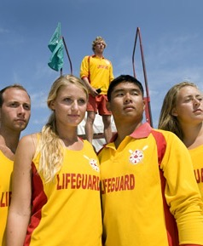
Safety Supervision Scanning
Supervision Zones
Designated area of supervised water scan and observe
Usually set out based on factors such as potential hazards, blind spots number of swimmers, and type of activities going on in the pool
Set out by supervisory staff (guards may recommend modification) based on factors such as number of lifeguards available, blind spots, patron behaviour, etc.
Elevated stations vs. ground patrols (roving lifeguards)
Item 14: Alert Ch. 2; Alert Insert
Notes:
When teaching candidates about supervision zones, there are several things to keep in mind:
The assistant lifeguard’s line of sight and field of vision are important factors in choosing positions for effective observation of a designated zone.
Human vision is best focused when the observed object is directly in front of the eyes.
Objects in peripheral vision cannot be seen clearly or in detail. This is why assistant lifeguards must be careful to keep turning their heads to clearly monitor the whole area.
Ideally, assistant lifeguards are positioned to minimize the distance the head must turn in order to effectively scan the zone.
Factors that could effect the scanning of your zone can include potential hazards, blind spots, the number of swimmers, and the type of activities going on in the pool.
The zones are often set out by supervisory staff, and assistant lifeguards may recommend modifications to their zone based on factors such as the number of lifeguards available, blind spots, patron behaviour, and more.
- Using the supplement found in the Bronze Medals Award Guide, I encourage you to compare guarding from an elevated station vs. a roving position.
Learning Activity: In groups, come up with pros and cons of guarding at an elevated station vs. a ground patrol.

Slide 37
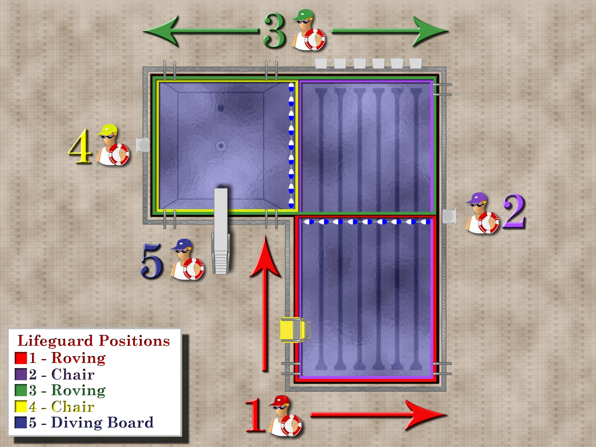
Positioning of Guards: - Sight lines - Elevated stations - Ground-level patrols - Rotations and breaks - Shifting to cover - Special features (ex. diving board)
Lifeguard Position and Supervision Zones
Item 14: Alert Ch. 2; Alert Insert
Notes:
When positioning assistant lifeguards, there are several things to consider, such as sight lines, elevated stations, ground level patrols, rotations and breaks, shifting to cover, and guarding special features like water slides and ropes.
In this example diagram, you can see several different guarding zones and positions:
Positions 1 and 3 are ground-level patrols
Positions 2 and 4 are in elevated stations
We also see the different supervision zones each assistant lifeguard has, for example:
Position 1 is responsible for just the shallow end (shown in red), while position two is covering all 6 lanes (which is shown in purple)
Position 4 is responsible for just the deep well, shown in yellow.
There are times when an additional person is needed for specialty features, like diving boards, ropes and slides, as these are more high risk areas. We can see position 5 is stationed at the diving board.
The position and quantity of lifeguards shown in this image are just an example, and even at this pool, this could change based on several variables, such as:
The location of the patrons swimming, for example if the large majority of swimmers are in the shallow end
Blind spots could affect the position and this could change even by the time of day with glare coming from windows in the facility
The behaviour and activities of certain patrons swimming may require more attention
The ability to see the top, middle, and bottom of the pool from the lifeguard position
The number of lifeguards and assistant lifeguards on duty
The number of patrons swimming
The shape and size of the facility
And the ability to respond quickly in an emergency, just to name a few

Slide 38
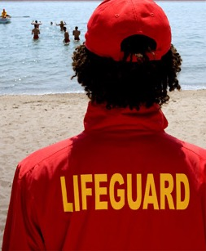
Safety Supervision Scanning
How to Scan
Systematic visual (with eyes) sweeps of a given zone of coverage (encourage head movement to ensure that they are not using peripheral visions).
Use peripheral vision to detect movement.
Scan of a zone should not be faster than 10 sec. & no longer than 30 sec.
Scan the pool bottom first, then the surface.
Focus on people and what they are doing. Make eye contact, watch face.
Look and listen for the unusual.
Avoid staring fixedly at the same thing. Give your eyes a break by focusing momentarily on some distant object or the horizon.
Never stop scanning when speaking with a patron.
In outdoor facilities, monitor changes in environmental conditions for impact on patron behaviour and safety.
Item 14: Alert Ch. 2, 3; Alert Insert
Notes:
Scanning a beach is significantly different from scanning a swimming pool but the basic principles are the same. Effective scanning assumes that assistant lifeguards can see the entire area, that they know what they are looking for, and that they will recognize it when the see it
Assistant lifeguards must be positioned with clear, unobstructed sight lines
They must move to counteract patron interference, especially in ground-level supervision
They take steps to minimize the effect of reflection or glare. To do this, they can change position, and use polarized sunglasses, to list a couple
Scanning strategy must compensate for an inability to see below the surface, like when you are at a waterfront and for distance from patron activity. The use of binocular can assist here.
Assistant lifeguards must practice to develop and improve perception skills.
They must understand the signs of potential trouble, and the characteristic behaviours of those in need of help.
Even if there are only a few people swimming, or they are all in one small area of the pool, assistant lifeguards must still scan their ENTIRE zone and surrounding deck.
You will need to discuss how to scan with your Bronze Cross candidates, and the items listed on this slide can be found in the supplement in the Bronze Medals Award Guide.

Slide 39
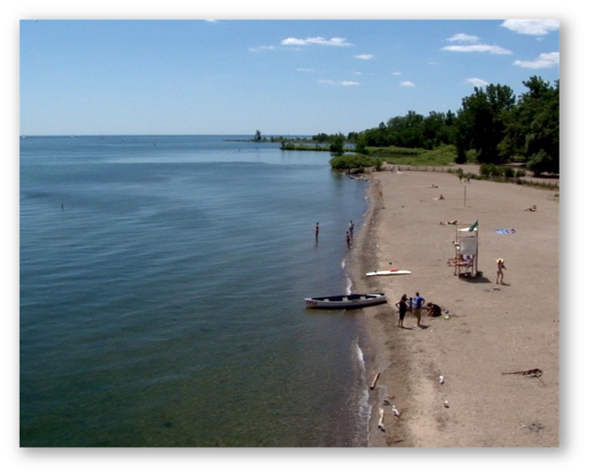
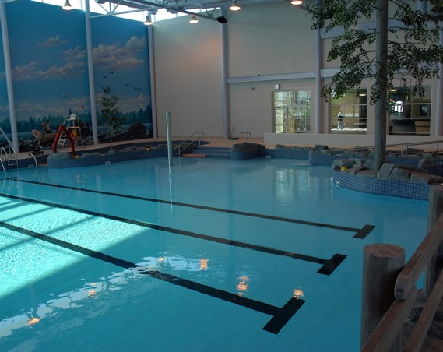
Pool vs. Waterfront Visibility
Item 14: Alert Ch. 2, 3, 12
Notes:
It would be a good exercise to brainstorm with your candidates the differences between scanning a pool environment compared to a waterfront environment.
- Candidates should be prepared to discuss additional challenges that they will have to face while supervising a waterfront?

Slide 40
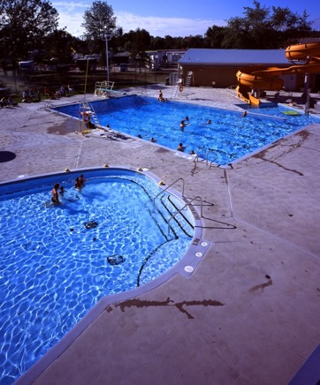
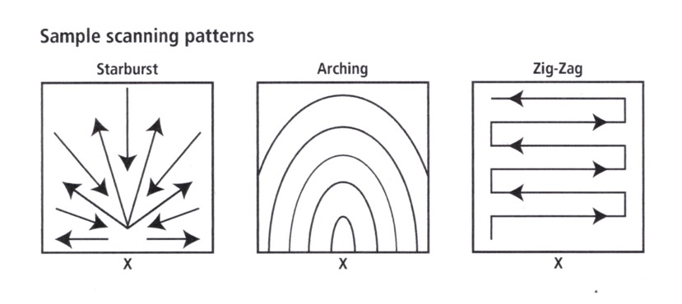
Safety Supervision Scanning
Ways to Scan
Item 14: Bronze Medals Award Guide Supplement; Alert Insert
Notes:
Some sample scanning patterns that you can teach your candidates include starburst, arching, and zig-zag.
I’m going to review several points that I would like you to teach to your Bronze Cross candidates.
Sweep your eyes over your zone, moving your head to see things to the right and left, and looking behind you regularly.
Take note of patrons and activity right in front of you.
Assistant lifeguards in an elevated station must remember to look below them.
Include adjacent assistant lifeguards on each sweep to receive any visual communications they might be sending and to check the area behind them.
Scan below the surface and, in swimming pools, scan the bottom regularly.
Attend to the “hot spots” more often, like diving boards, rafts, drop-offs, buoylines, ladders, and toys
Ensure that each person who enters the water from a dive, slide, or diving board, resurfaces.
Remember that an activity “hot spot” can move with the people who create it.

Slide 41
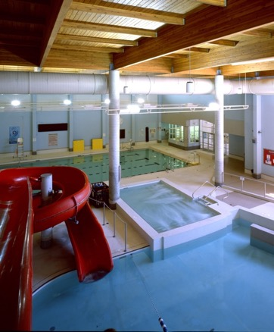
Safety Supervision Scanning
Recognition and Intervention
It is important that lifeguards are able to recognize potential hazards and people in danger, and intervene
When an assistant lifeguard notices a hazard they must report it to a lifeguard or supervisor right away
The goal of scanning is to trigger the appropriate intervention
Some scanning strategies include:
Head counting
Grouping
Mental filing
Profile matching
Item 14: Alert Ch. 2, 3
Notes:
Experience is a very good teacher. Over time, assistant lifeguards develop a discerning eye and nose for potential trouble.
Experienced assistant lifeguards develop good pattern recognition skills and are faster at detecting disturbances or anomalies in those patters than new assistant lifeguards.
Training and practice will help prepare the new assistant lifeguard for those early days on the job.
If you are unsure of something you are seeing in the water, don’t hesitate, and respond (it’s better to be safe than sorry).
Assistant lifeguards must be able to recognize potential hazards and people in danger and intervene. They must also report hazards to a lifeguard or supervisor right away
Details regarding teaching scanning strategies can be found in the supplement of the Bronze Medals Award Guide, and should be reviewed with candidates
When teaching scanning, just like any other skill, I recommend using progressions. For example, have your candidates observe a public swim and tell them to simply scan and report back on what they observed. They will have difficulty with this as they do not know what to look for. Send them back again but this time have them observe patron behaviours and report back. Continue to add on to what they are to observe and report back. You can add things like, what do you notice when scanning the bottom, middle, or surface of the water. What about the deck. Include other assistant lifeguards in your scan. As they practice, they will begin to notice more things, they will be scanning more successfully, and they will become more confident when reporting.

Slide 42
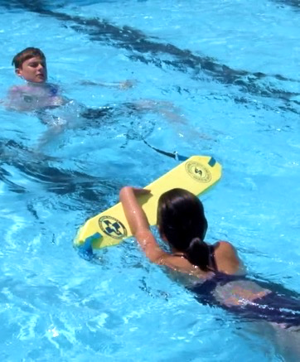
Assistant Lifeguard Situations
New Bronze Cross Judgment Item
As a member of an assistant lifeguard team, respond to an emergency in a supervised aquatic setting
Continuous and systematic scanning
Timely recognition and appropriate response
Effective communication with lifeguards, victim(s), patrons
Appropriate first aid treatment, EMS activation
Victim types: e.g. weak or tired swimmer, distressed non-swimmer, unconscious victim, injured victim, spinal injury, non-breathing victim
Continued safety supervision throughout
Concern for good public relations
Item 17: CLM Ch. 4, 7.2, 7.5, 8, 9.3 Alert Ch. 2, 3
Notes:
Appendix in Award Guide: Designing Assistant Lifeguard Situations
Progression to National Lifeguard
What instructor should know:
Simulated rescue situations – to develop and improve judgment, candidates must have the opportunity to solve problems and make decision.
You can provide this opportunity through situational training. In situational training, you outline a situation or scenario that requires rescuers to make decisions about what action to take.
Ensure rescue scenarios are appropriate for the award level and fall within the requirements of the test item (Appendix B in the award guide will assist here).
Realistic victim simulations are critical; rescuers cannot make appropriate decisions when victims do not portray the victim type accurately.
Designing situations: in early situational training, keep rescue scenarios simple and straightforward.
As candidates gain experience and confidence, scenarios may become increasingly challenging (within the limits of the award level)
Increase the number of variables the rescuer must address
Situation may evolve
Circumstances might change
The victim condition might change (level of consciousness, respiratory rate, pain, etc.)
The equipment available might be sparse

Slide 43
Assistant Lifeguard Situations
Setting up an Assistant Lifeguard Situation
Realistic situations taken from the award guide, Appendix A
Set situations up so candidates will be successful
All situations need to encourage judgment at a manageable level
Recommended to use teams of 2 Assistant Lifeguards
Provide feedback so candidates know how to improve
Item 17: CLM Ch. 4, 7.2, 7.5, 8, 9.3 Alert Ch. 2, 3
Notes:
Setting up situations – brief the rescuers on their environment, position of rescuers, available rescue aids and first aid supplies
Do not explain the victim type and behaviours or the precipitating incident to the rescuer.
To develop judgment, learners need an opportunity to assess what is unfolding in front of them and to adapt as their assessment evolves and circumstances change.
Brief the victims on their environment, victim type and behaviours, and the precipitating incidents they are to role-play.
Stress the importance of good victim simulations, as this allows learners to make appropriate choices about how to respond.
Assistant Lifeguard Situation Design – There are many factors to consider when designing and executing rescue situations
set-up and re-set of the rescue scenarios
Managing the behaviours of multiple victims at different times
Setting up the activities of those who are not involved in the rescues directly (e.g.. The role of bystanders)
LSS Instructors must ensure the set-up and changeover of situations is timely while providing the opportunity for candidates to demonstrate their abilities to properly recognize and react. This is important since scanning and recognition are imperative to effective rescue response.
Consider setting up two groups at once, preparing the victims for several situations in advance, or repeating situations (as long as the rescuers are not privy to the first scenario).
This will help to ensure that you have time to monitor the victim and the rescuer, the rest of the team, the unfolding of the rescue situation, and the involvement of multiple bystanders, equipment, EMS, etc.
I recommend you have your teams and situations prepared in advance, this will save you time on your transitions.
When setting up your victims, ensure the Assistant Lifeguards are setting up in an area that they cannot see or hear what you are discussing
Select candidates to act as victims, I recommend you review victim simulation with them at this time
Provide the victims with a time or cue as to when they are to proceed during the situation
Situations can be setup to be preventable as well (for example, the assistant lifeguard may notice a gutter grabber, and stop them before they become a non-swimmer)
An assistant lifeguard team should have the chance to rescue multiple victims, and try difference positions and supervision zones before switching to the next team
Ensure to provide feedback after each team finishes their round of situations. I recommend you do this with the whole class so everyone can learn from the experience.
To help with remembering the feedback, I recommend you use evaluation sheets, which are available on the lifesaving society’s website.

Slide 44
Team vs. Individual Evaluation
Bronze Cross multiple rescuer items (15, 16, 17)
Formative evaluation (feedback): focus on both team effort and individual candidate performance.
Summative evaluation (pass/fail): focus solely on individual candidate performance.
Notes:
In assistant lifeguard situations, candidates perform as a member of an assistant lifeguard team. When teaching, formative feedback should focus on both the team effort and the individual performance. However, summative (pass/fail) evaluation must focus solely on the individual candidate’s performance

Slide 45
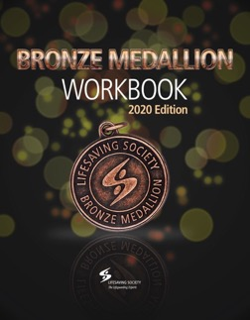
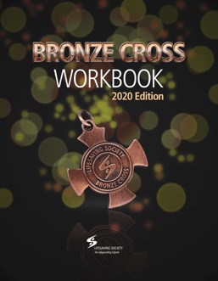
Additional Resources
New Bronze Medals Award Guide.
New online Explore Bronze PowerPoint tutorial.
New Teaching Bronze USB resources for instructors including in-person and blended learning core and lesson plans, learning activities, and PowerPoints.
New Bronze candidate workbooks.
New downloadable (2020) test sheets and Recertification test sheets for Medallion and Cross.
Visit Lifeguard Depot to order your resources today.
Notes:
Bronze Medals Award Guide: features supplemental technical information (not currently found in the Canadian Lifesaving Manual) and guidance on setting up lifesaving and Bronze Cross assistant lifeguarding situations.
- The current Medallion and Cross workbooks will be available only while supplies last.

Slide 46
Questions?

